Slide 1

Sayamon Hongjaisee, PhD
School of Health Sciences Research
Research Institute for Health Sciences (RIHES)
Chiang Mai University
sayamon.ho@cmu.ac.th

Slide 2
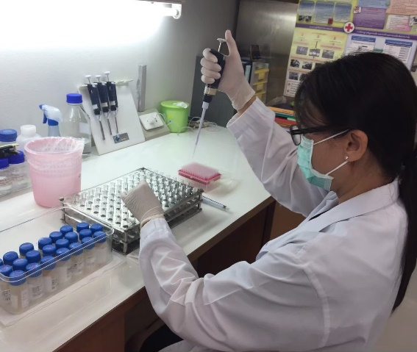
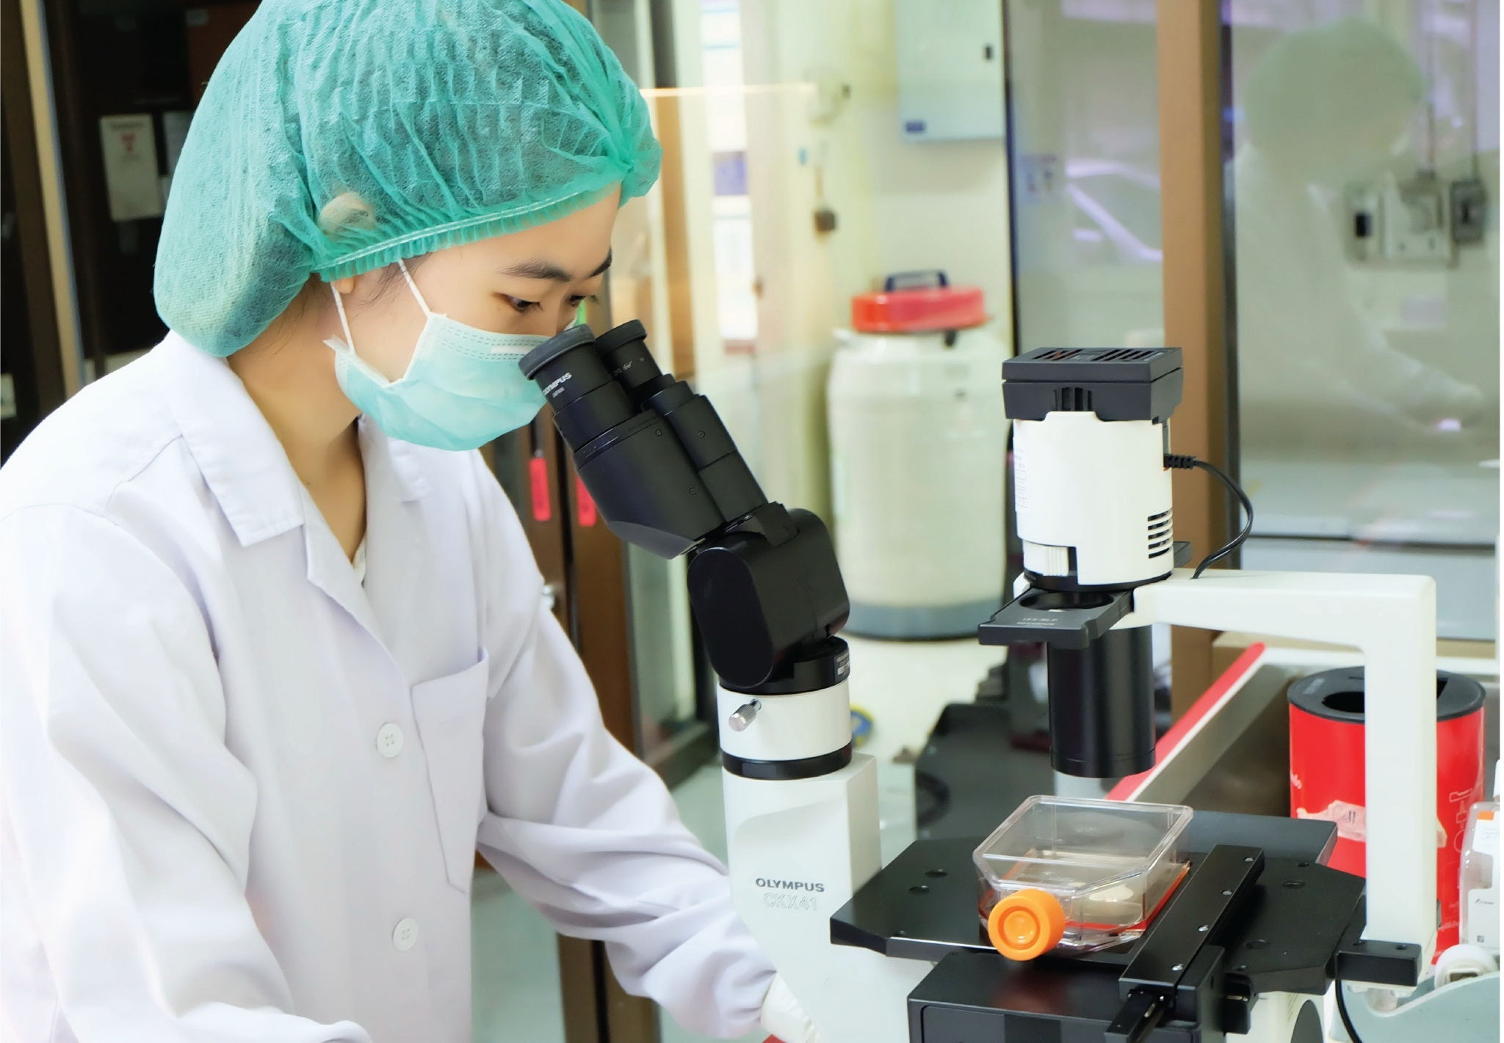
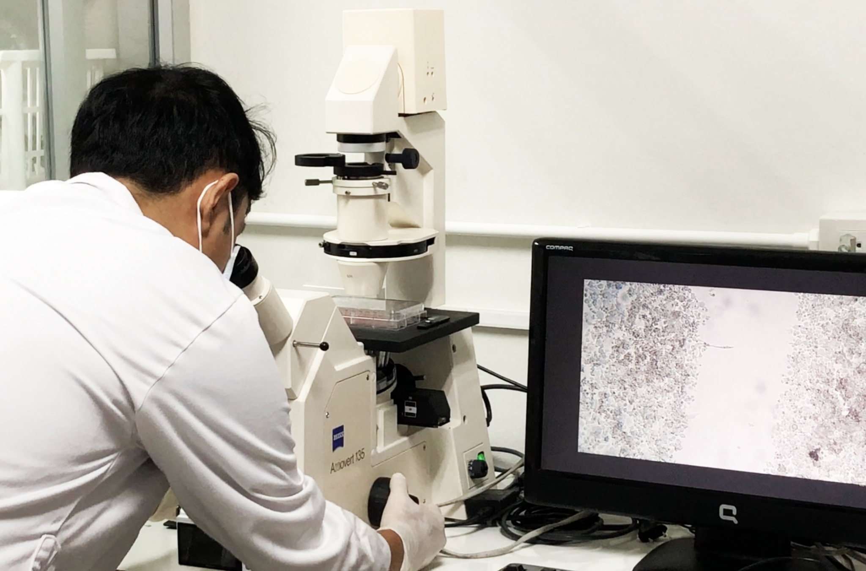
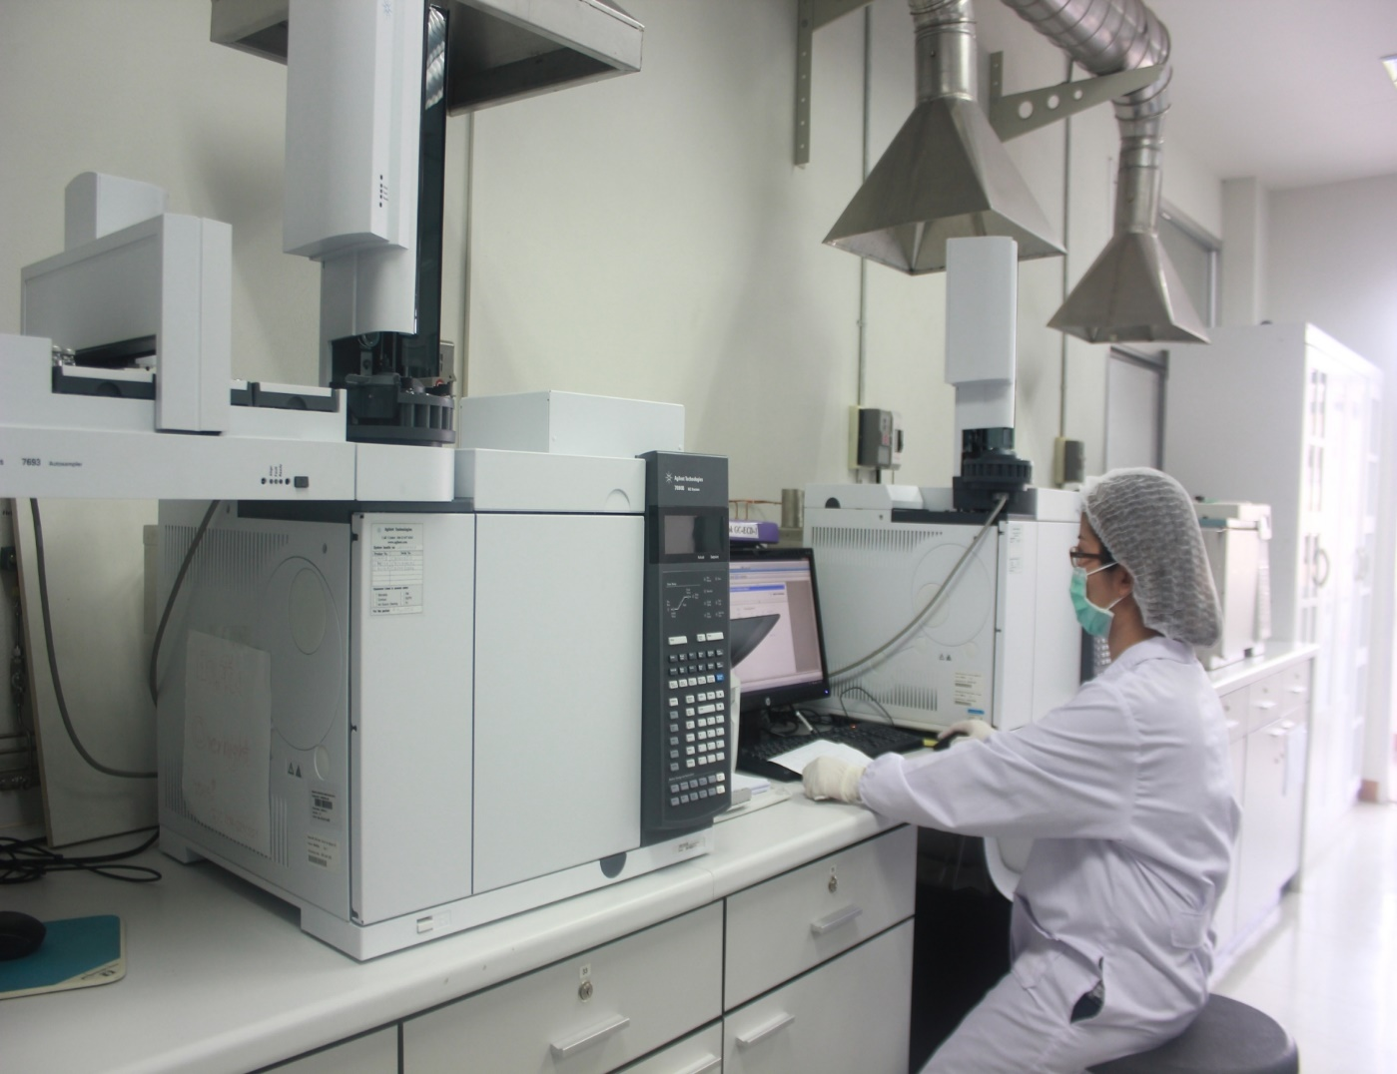
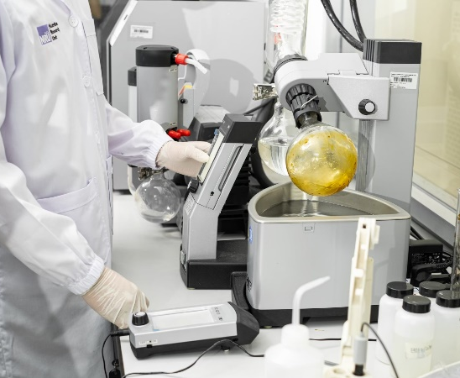
Research Institute for Health Sciences (RIHES)
Vision “Being the World-Class Research Institute for Health Sciences”

Slide 3
Research Institute for Health Sciences (RIHES)
Research center for infectious diseases and substance use
Research center for molecular and cell biology
Research center for non-infectious diseases and environmental health sciences
  Non-communicable disease research unit
  Environmental and occupational health sciences research unit
  Nutraceutical research and innovation unit
School of health sciences research

Slide 4

Research Institute for Health Sciences (RIHES)
31 Researchers/physicians/lecturers
45 Research assistants
48 Clinic staffs
47 Research supporting staffs
49 Back-office staffs

Slide 5
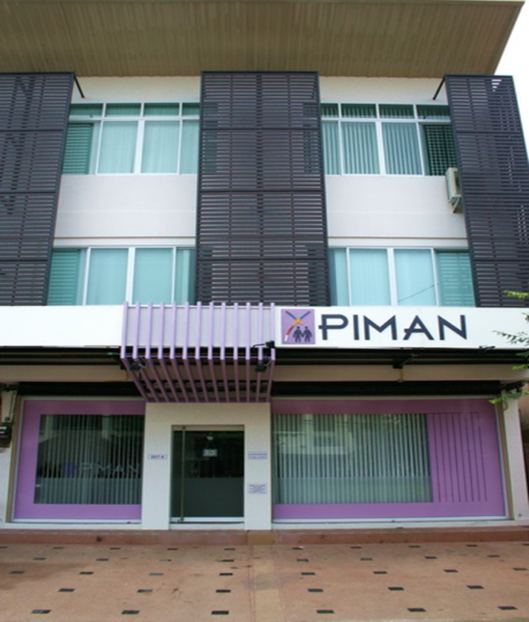
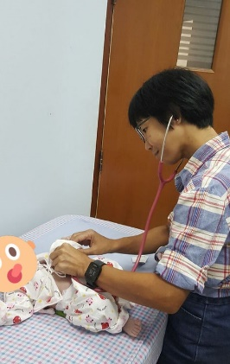
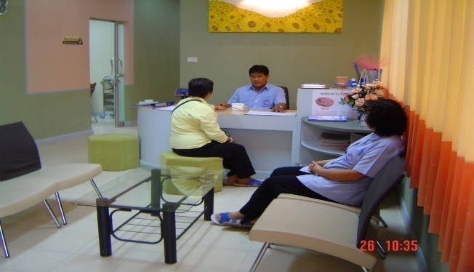
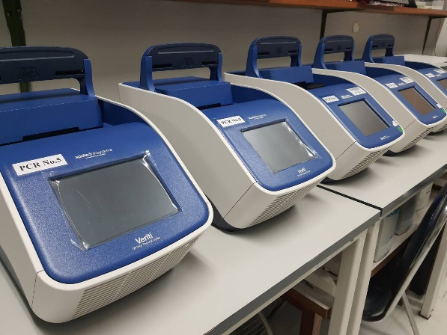
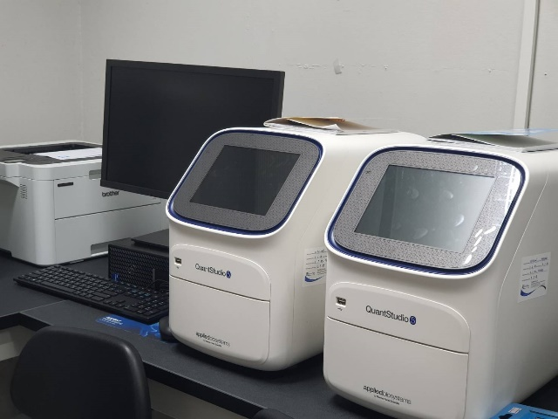
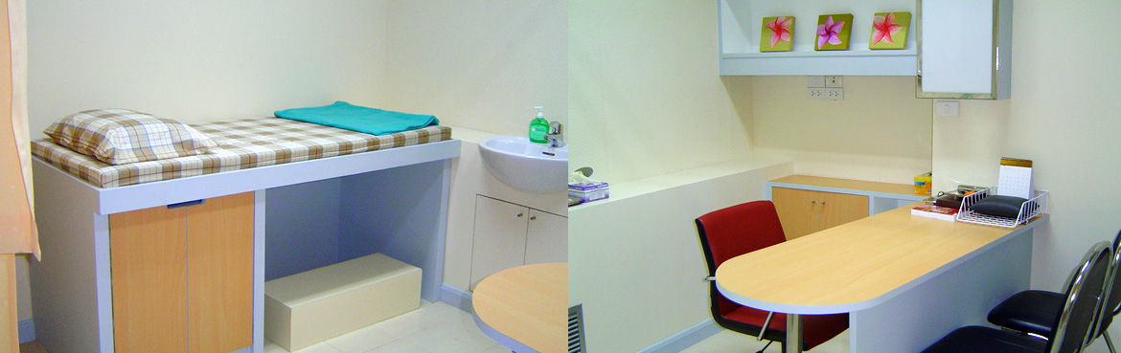
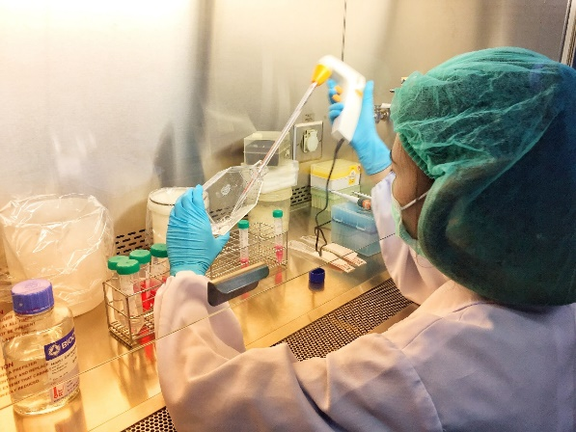
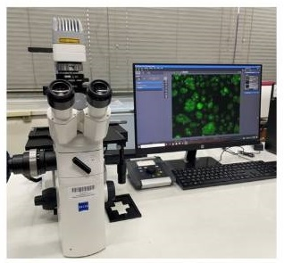
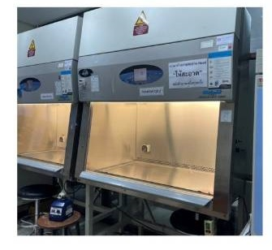
Clinical trial clinics (for clinical trial study)
Molecular and cell biology laboratory (cell culture lab, molecular lab, immunology lab, BSL-1, BSL-2, BSL-2 enhanced)

Slide 6
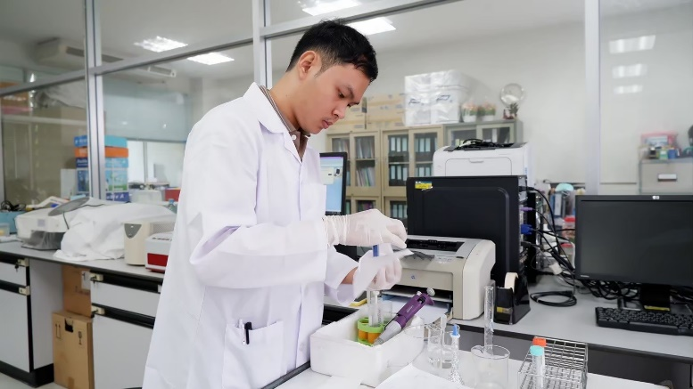
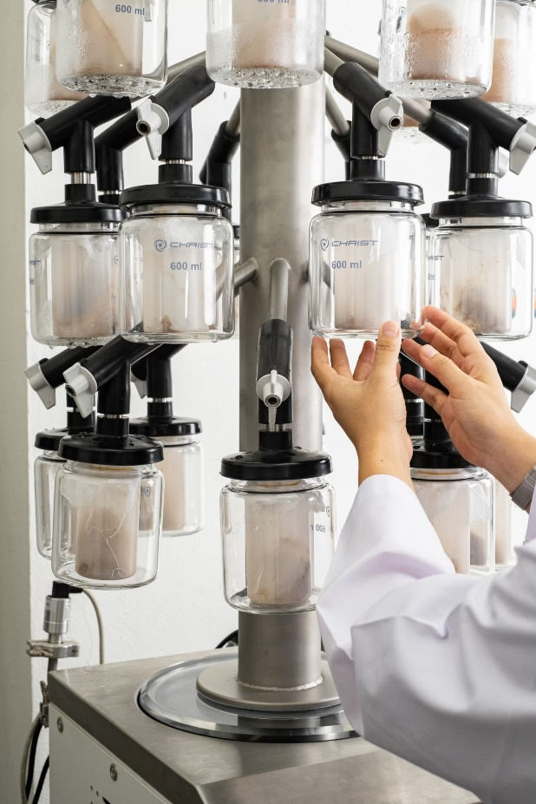
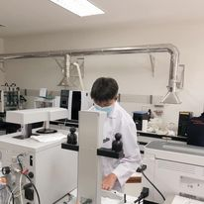
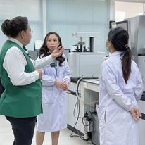
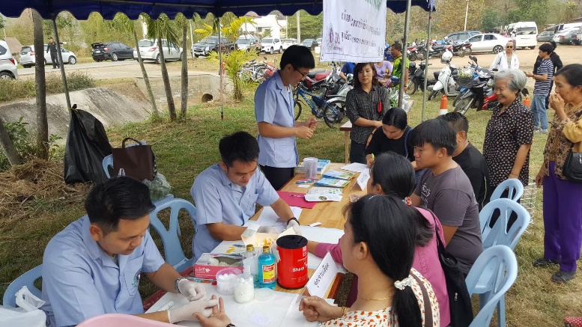
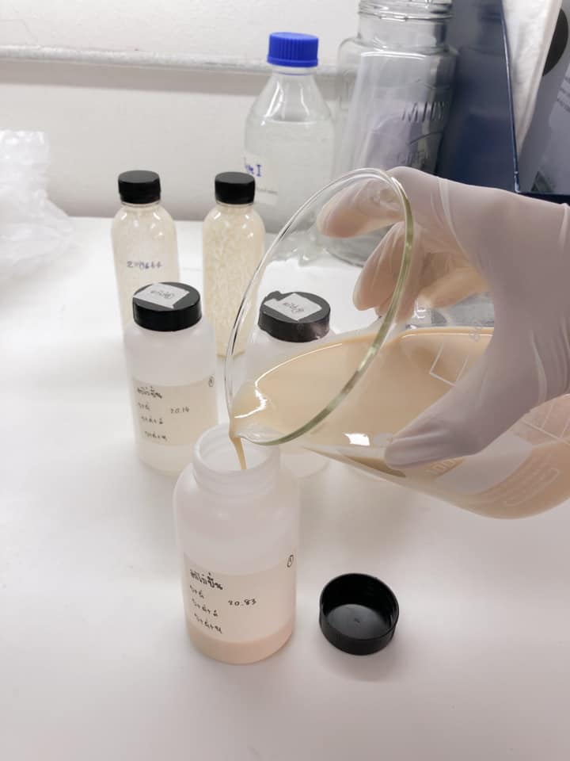
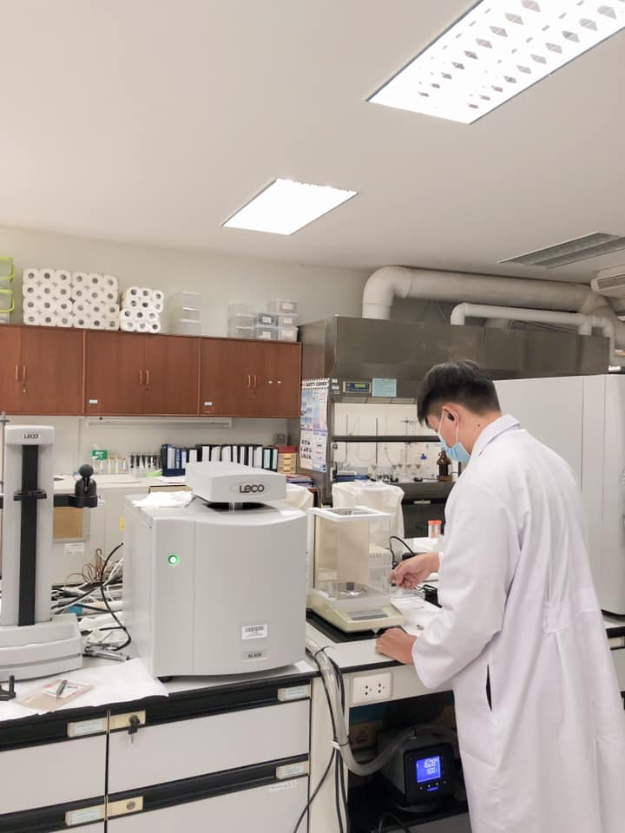
Nutraceutical Research and Innovation Laboratory (food testing, food products, herbs or medicinal plants)
Environmental and Occupational Health Science Research Unit Laboratory (pesticides detection, PM2.5, agriculture and environment, community services)

Slide 7
My research expertise
Molecular virology
Genetic characterization of viruses
Epidemiology of infectious diseases, tropical diseases
Molecular diagnosis of infectious diseases
Development of point-of-care-testing (POCT), simple and rapid test kits
  Using Loop-mediated isothermal amplification (LAMP)
  Using CRISPR/cas12 technique

Slide 8
Loop-mediated isothermal amplification (LAMP)
Molecular technique for amplification of nucleic acids (DNA or RNA)
High specificity and sensitivity (with 4-6 primers)
Isothermal amplifications (60-65°C)
Short time detection (30-60 min)
Water bath or heat block can be used
Naked eye detection

Slide 9
Assessment of prevalence of Streptococcus suis contamination in raw pork from fresh markets using LAMP technique (unpublished data)
20 raw pork samples from 3 fresh markets and 1 supermarket located in Chiangmai city were collected during January-February 2023.
LAMP-SS
10 positive samples (50%) for S. suis
LAMP-SS2
No positive samples for S. suis 2

Slide 10
How would you like to improve your research/activities?
Learn how to apply molecular technique to be a simple test kit (e.g., lyophilized LAMP, lateral flow strip, one-pot test kit)
What knowledge gaps would you like to address?
Simple and rapid test kit for early diagnosis of important pathogens
  Simple, friendly use, low cost, rapid detection
  No need for machine
  Naked eye detection
  Field usage
  Mass screening

Slide 11
What is the most important/pressing question you would like to address in a ONE-HEALTH research proposal ?
Simple test for early detection of pathogens causing human or animal disease
Human and animal disease surveillance for better mapping and prediction of emerging disease threats

